Slide 1
CORONA VIRUS ANALYSIS withSQL
Presented BY: Prakhar Mishra
PROFILE: DATA ANALYSIS INTERN
BATCH: MIP-DA-07
presented to : @mentorness

Slide 2

Overview
The CORONA VIRUS pandemic has had a significant impact on public health and has created an urgent need for data-driven insights to understand the spread of the virus. As a data analyst, you have been tasked with analyzing a CORONA VIRUS dataset to derive meaningful insights and present your findings.

Slide 3
Dataset Description
01 02 03 04 05 06 07 08
Province: Geographic subdivision within a country/region:
Country/Region: Geographic entity where data is
Latitude: North-south position on Earth's surface.
Longitude: East-west position on Earth's surface.
Date: Recorded date of CORONA VIRUS data.
Confirmed: Number of diagnosed CORONA VIRUS cases.
Deaths: Number of CORONA VIRUS related deaths.
Recovered: Number of recovered CORONA VIRUS cases.

Slide 4
Introduction
The virus spreads through small liquid particles from an infected person’s mouth or nose when they cough, sneeze, speak, sing, or breathe.
Practicing respiratory etiquette (like coughing into a flexed elbow) and self-isolating when feeling unwell are essential.

Slide 5


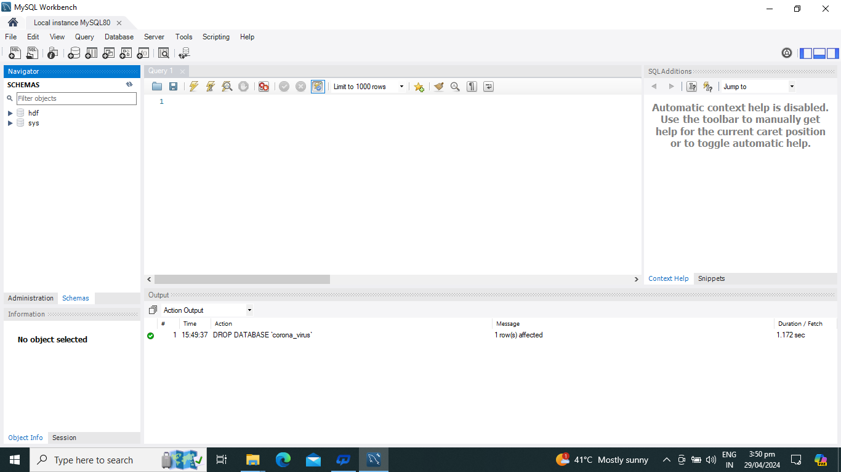
Use My Sql Workbench…
You could enter a subtitle here if you need it

Slide 6

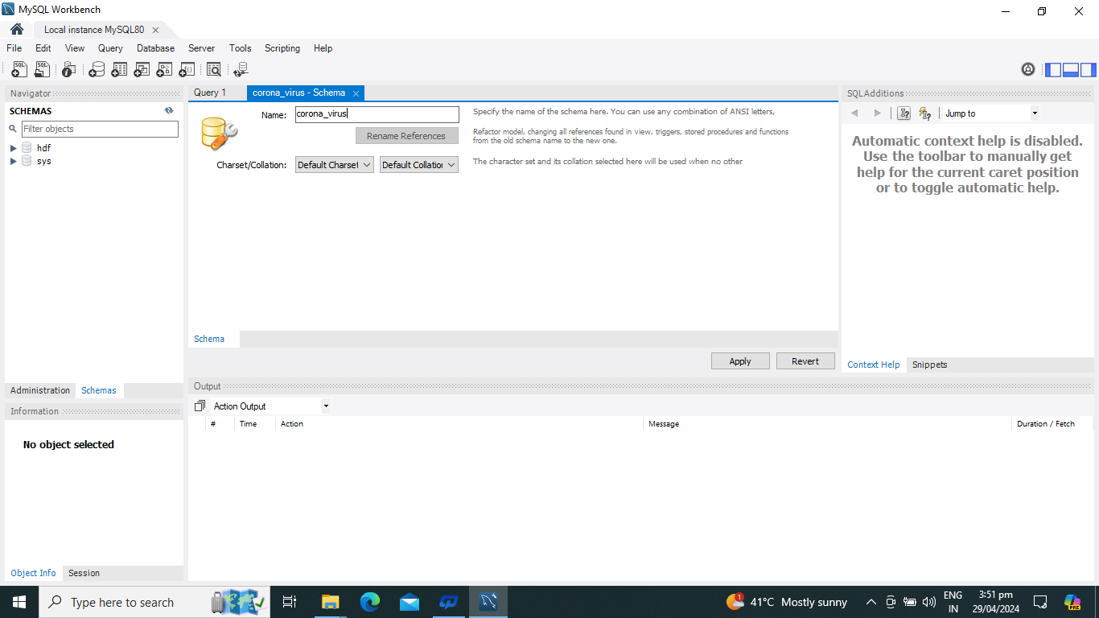

Create Database…

Slide 7
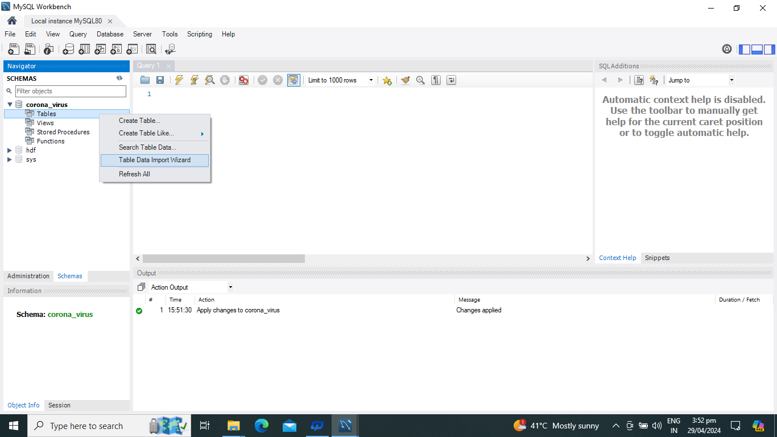
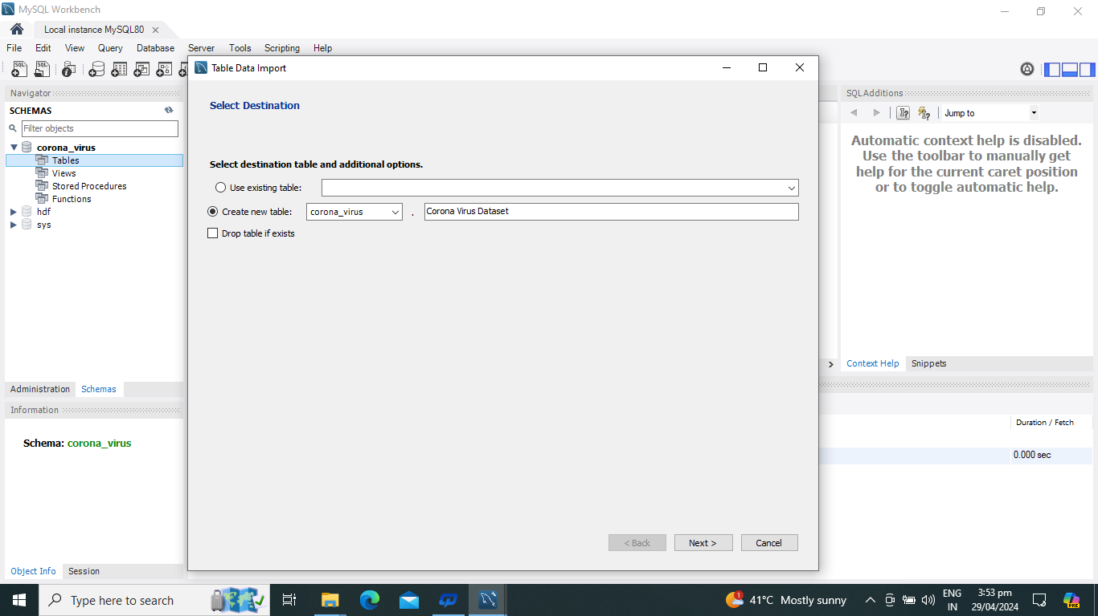
Table Data Import…
Create new table

Slide 8
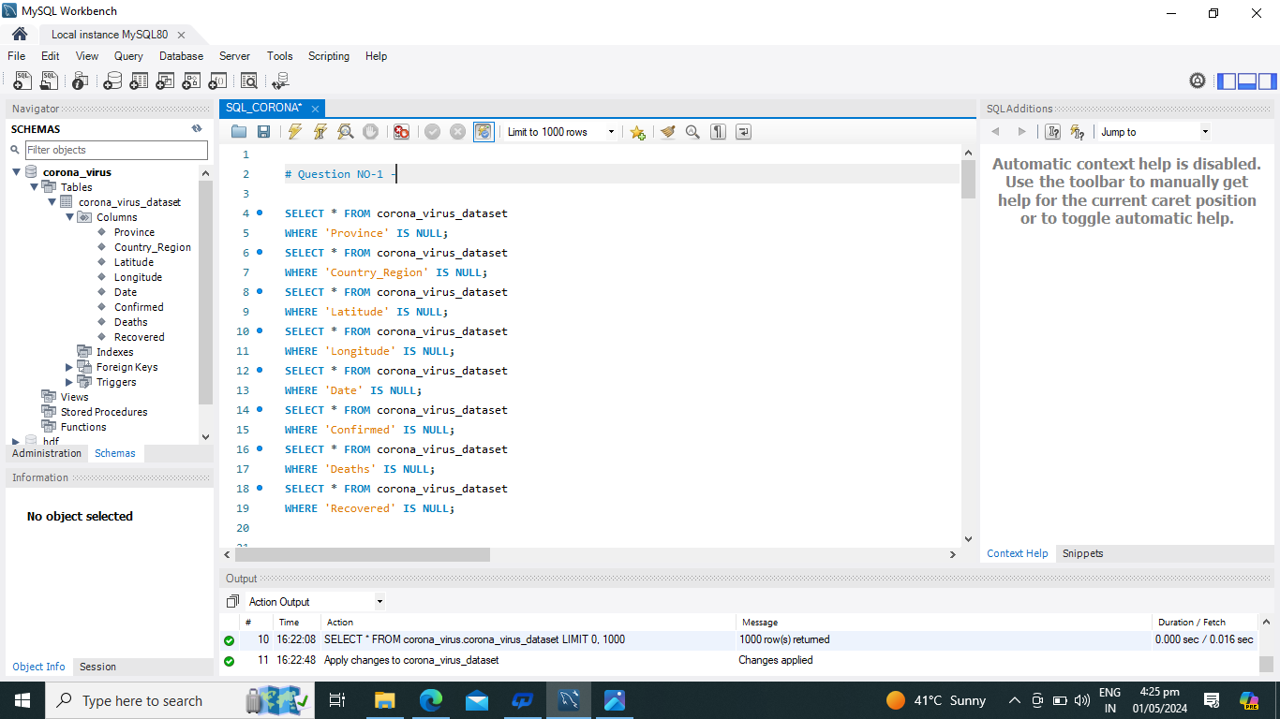
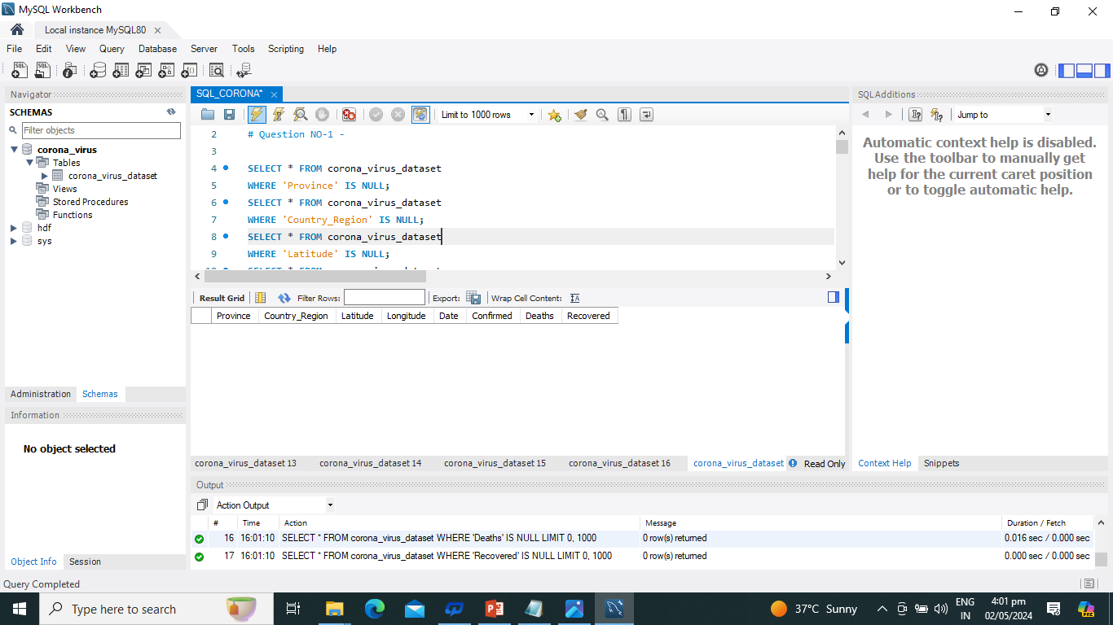
Q1. Write A Code To Check Null Values…
Result Grid

Slide 9
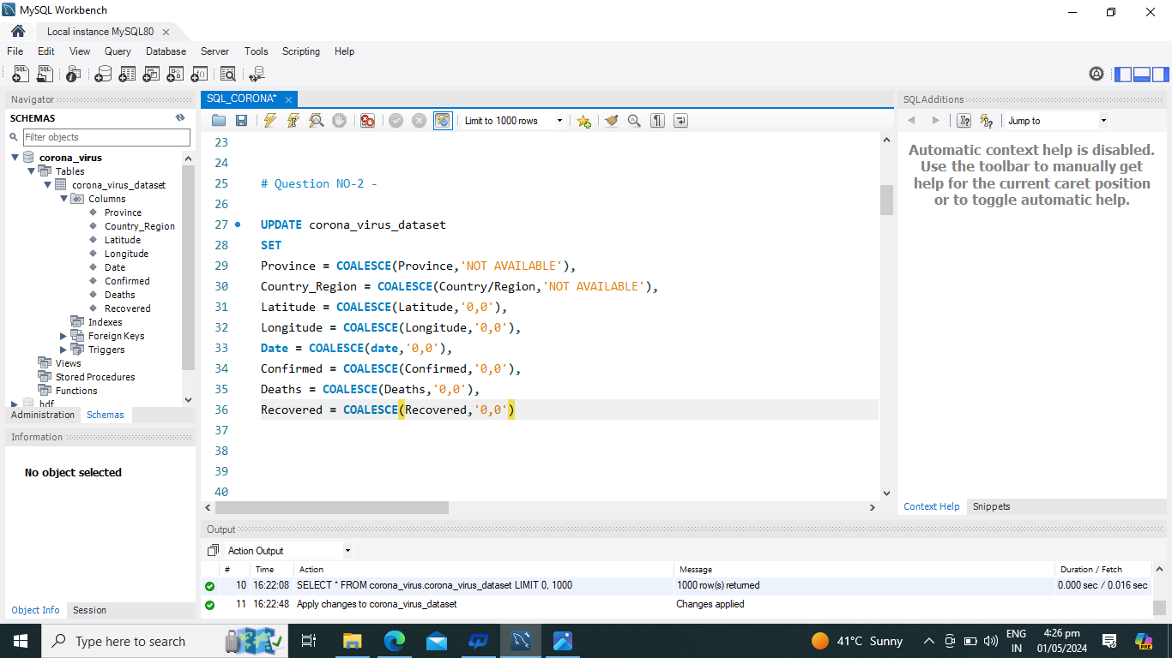
--Q2. If NULL Values Are Present, Update Them With Zeros For All Columns...

Slide 10
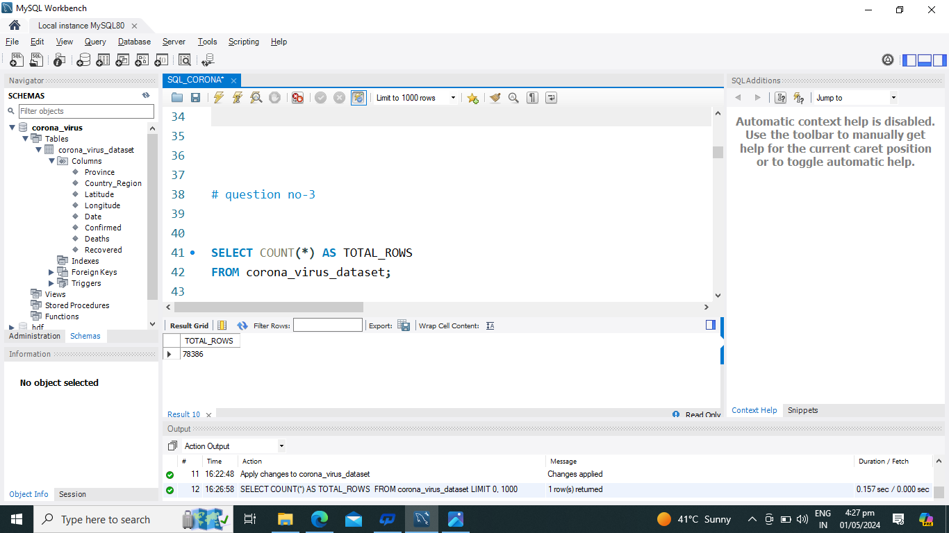
-- Q3. Check Total Number Of Rows…
Result Grid

Slide 11
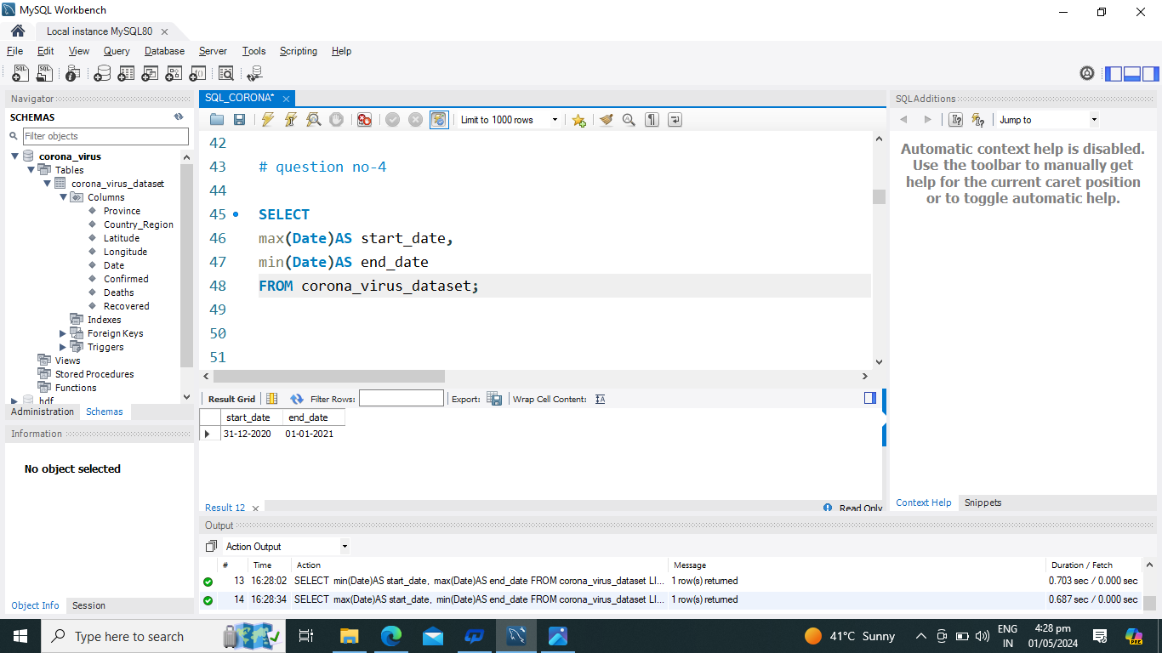
-- Q4. Check what is start_date and end_date…
Result Grid

Slide 12

-- Q5. Number of month present in dataset…
Result Grid

Slide 13
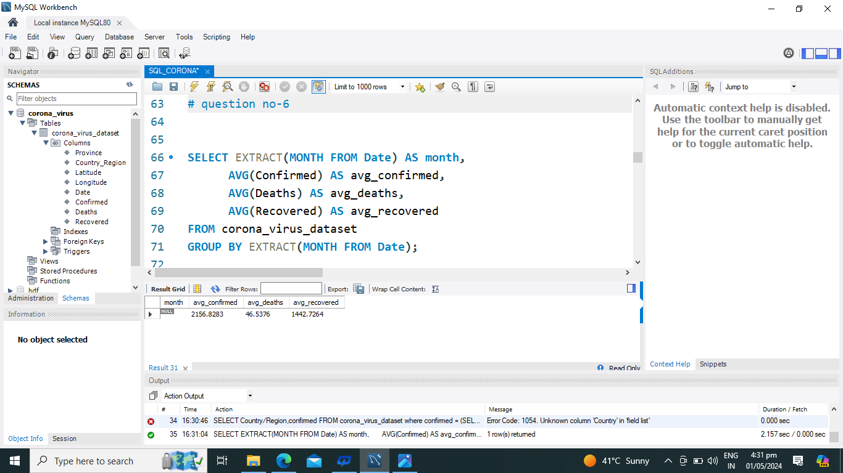
-- Q6. Find monthly average for confirmed, deaths, recovered...
ResuGlt rid

Slide 14
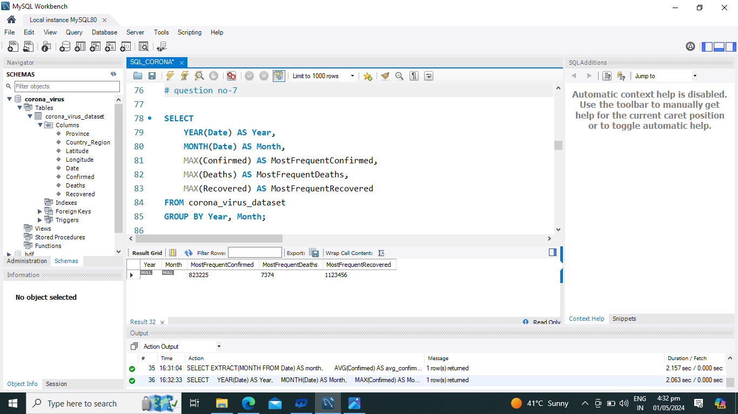
-- Q7. Find most frequent value for confirmed, deaths, recovered each month…
Result Grid

Slide 15

-- Q8. Find Minimum Values For Confirmed, Deaths, Recovered Per Year…
Result Grid

Slide 16
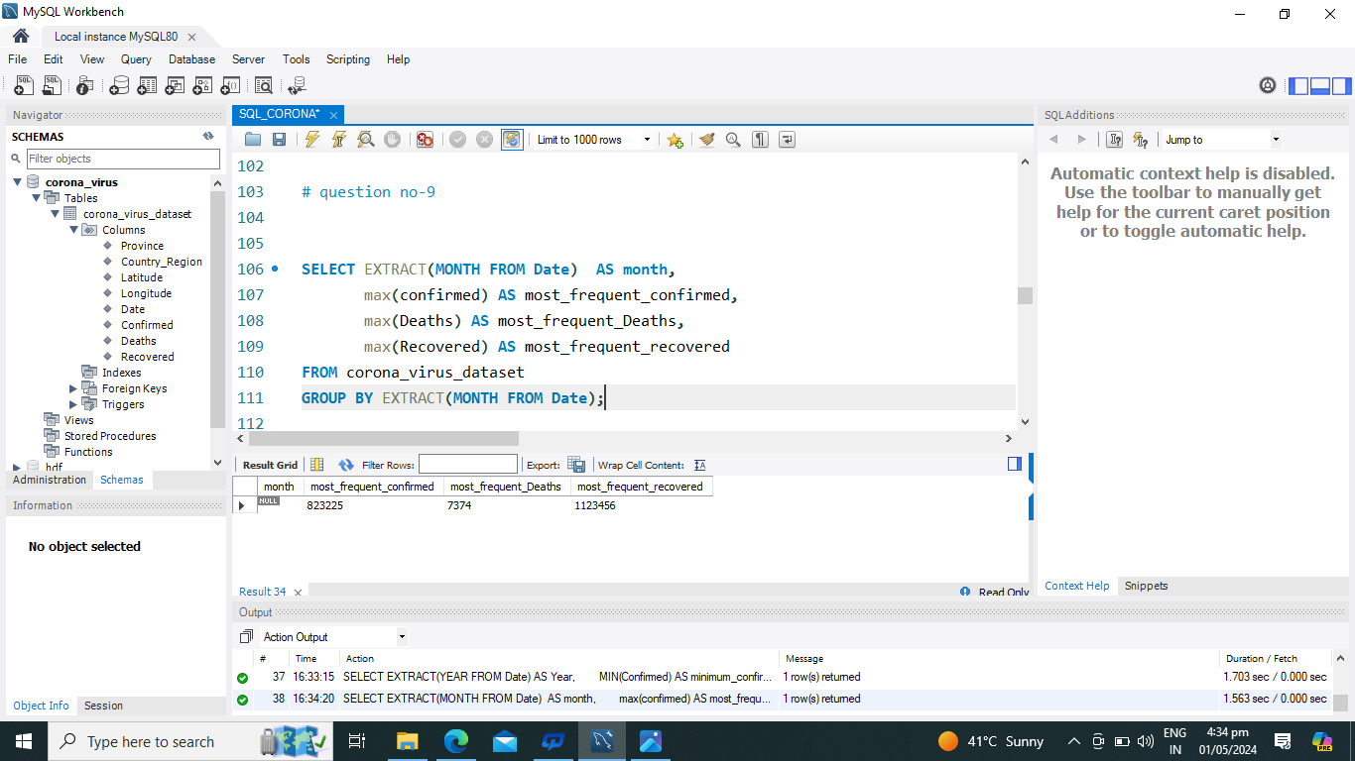
-- Q9. Find Maximum Values Of Confirmed, Deaths, Recovered Per Year…
Result Grid

Slide 17
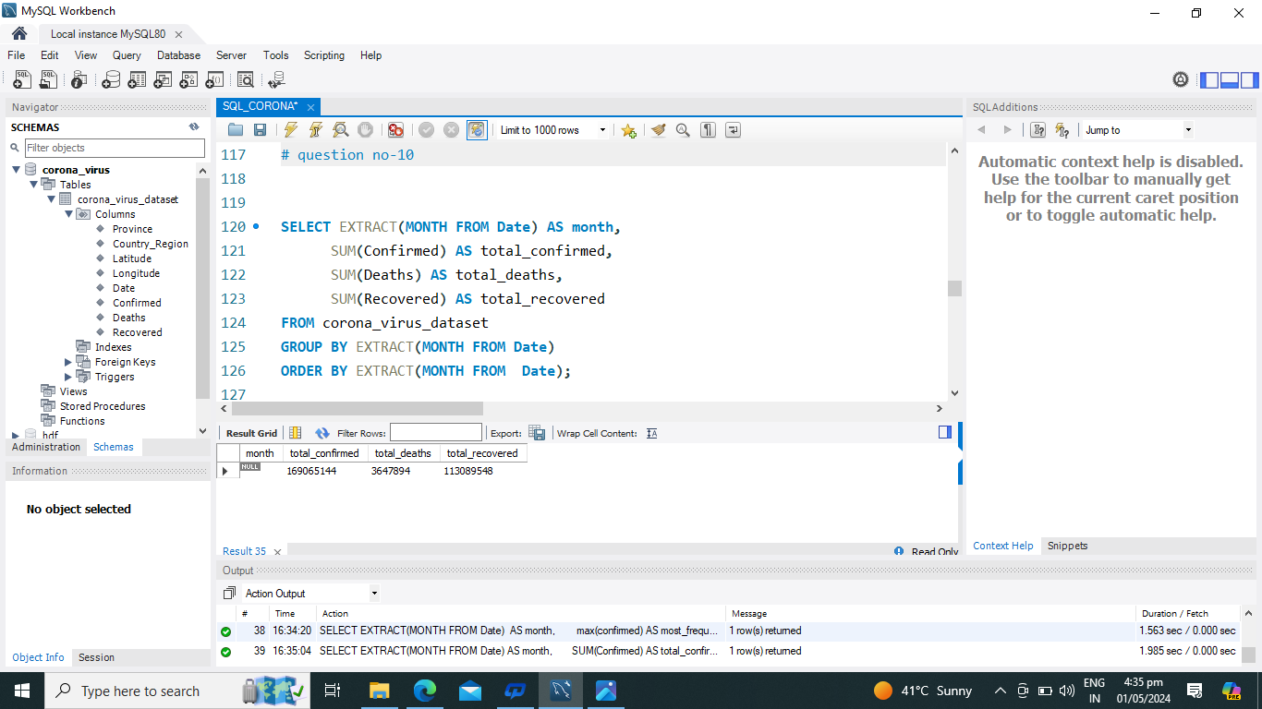
-- Q10. The Total Number Of Case Of Confirmed, Deaths, Recovered Each Month..
Result Grid

Slide 18
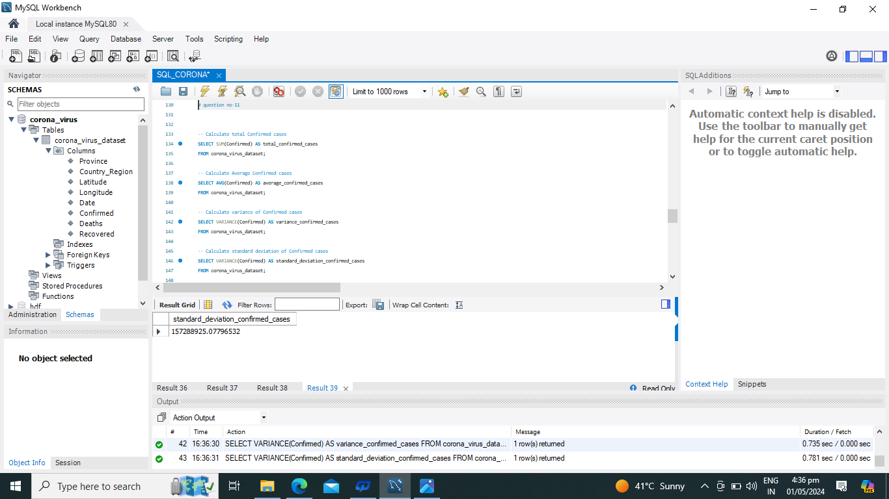
-- Q11. Check How Corona Virus Spread Out With Respect To Confirmed Case -- (Eg.: Total Confirmed Cases, Their Average, Variance & Standard.)
Result Grid

Slide 19

-- Q12. Check How Corona Virus Spread Out With Respect To Death Case Per Month -- (Eg.: Total Confirmed Cases, Their Average, Variance & STANDARD)
Result Grid

Slide 20

-- Q13. Check How Corona Virus Spread Out With Respect To Recovered Case -- (Eg.: Total Confirmed Cases, Their Average, Variance & STANDARD)....
Result Grid

Slide 21
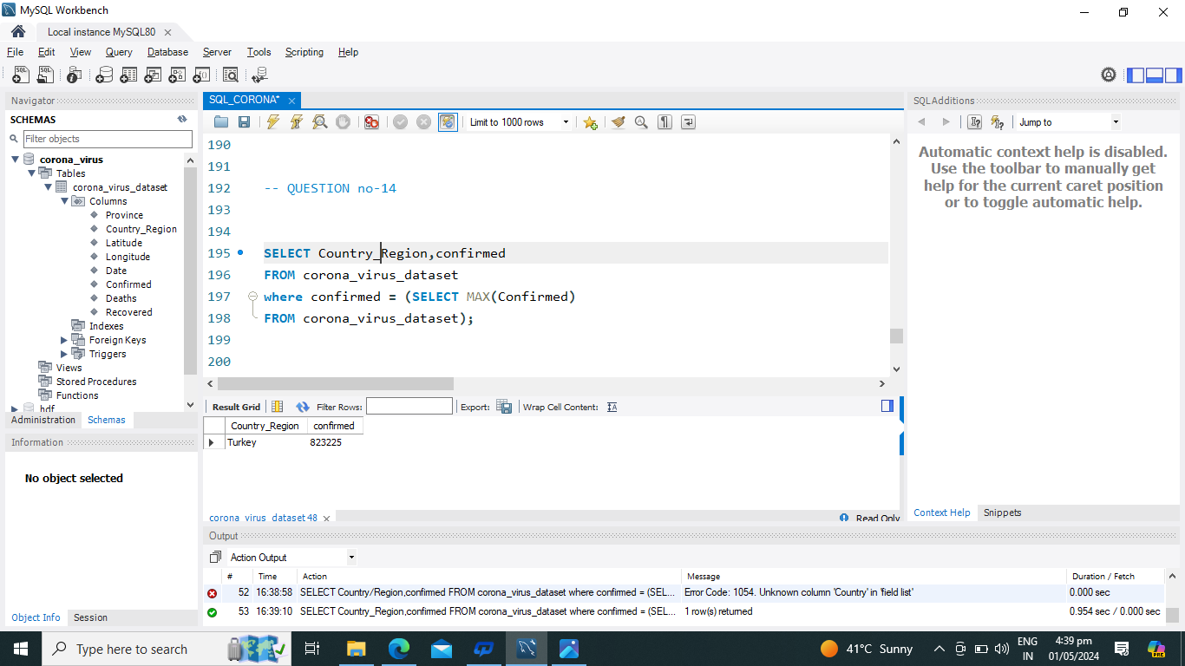
-- Q14. Find Country Having Highest Number Of The Confirmed Case…
Result Grid

Slide 22
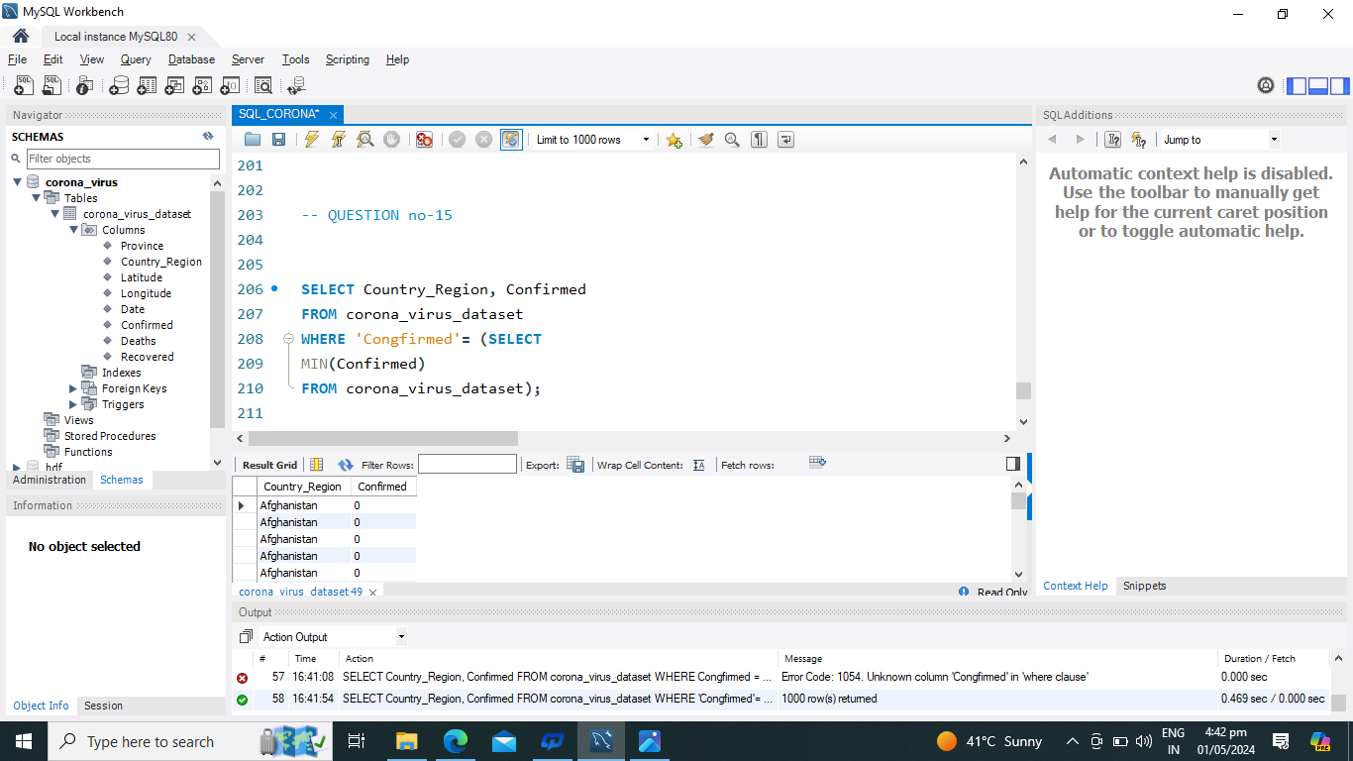
-- Q15. Find Country Having Lowest Number Of The Death Case…
Result Grid

Slide 23
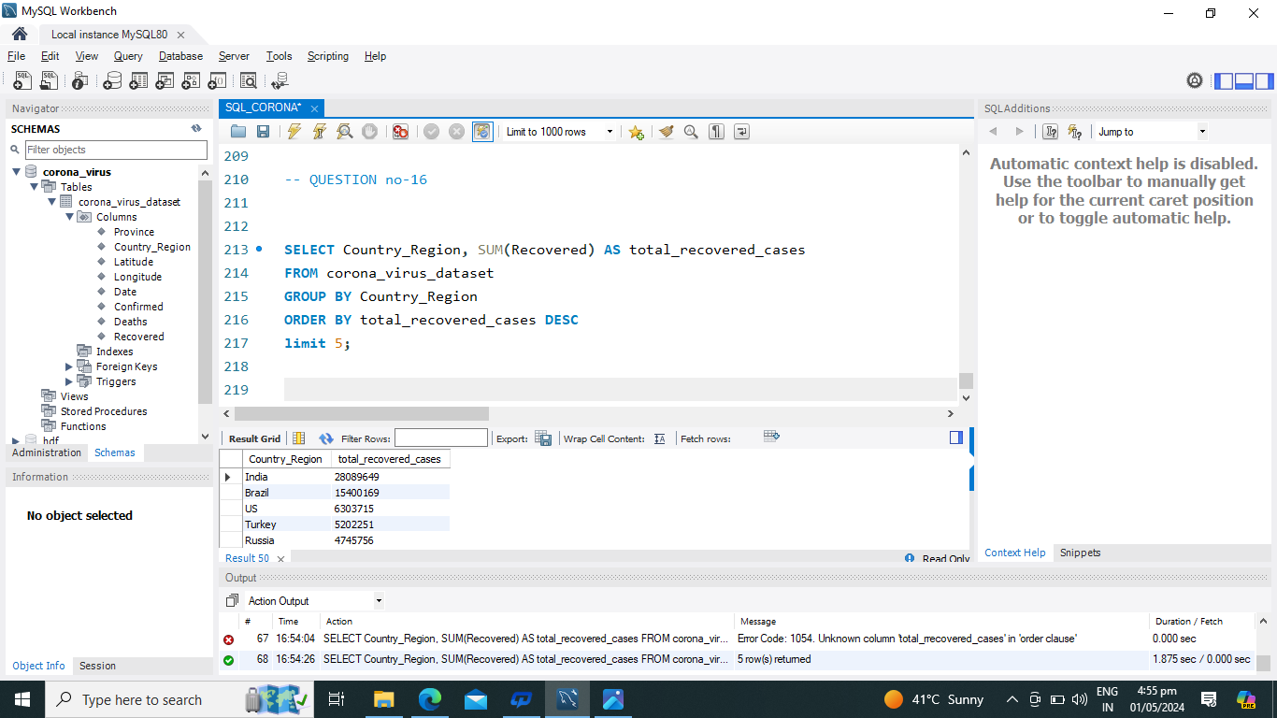
-- Q16. Find top 5 countries having highest recovered case….
Result Grid

Slide 24





